Slide 1
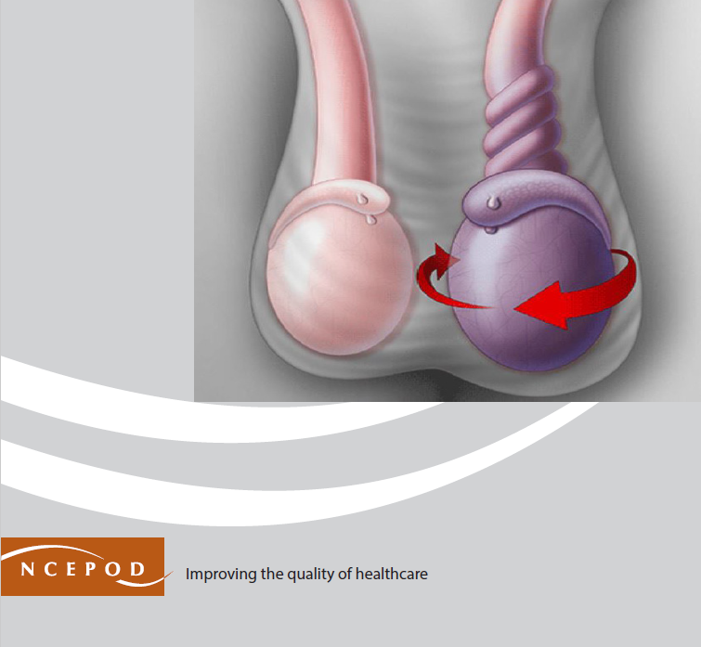
Twist and Shout
A review of the complete pathway and quality of care provided to children and young people 2 – 24 years of age who present to hospital with testicular torsion
Key messages and recommendations
Notes:
Presenter’s notes:
This presentation can be used to present the principal recommendations from the report ‘Twist and Shout’. A review of the pathway and quality of care provided to children and young people aged 2-24 years who presented to hospital with testicular torsion.
More information can be found at

Slide 2
The study
Aim
To review the complete pathway and quality of care provided to children and young people 2 – 24 years of age who present to hospital with testicular torsion.
Data collection tools
Organisational questionnaire
Clinician questionnaire
Primary care questionnaire
Case note review
Patient/carer online survey
Clinician survey and interviews
Notes:
Presenter’s notes:
The study described in this report aimed to examine the complete pathway and quality of care provided to children and young people 2 – 24 years of age who presented to hospital with testicular torsion between 1st April 2021 – 31st March 2022.
A clinician questionnaire was sent to the surgeon who was responsible for the care of the patient at the time of the operation. The study included acute hospital providers where patients with testicular torsion might be admitted. Primary care practices were also asked to participate if it was identified that a patient selected for inclusion in the study was admitted to hospital following a referral from primary care.
The anonymous patient;/carer survey was circulated online to allow all young people who were admitted with testicular torsion to provide their views on the care received as an inpatient. An anonymous clinician survey and interviews were undertaken to collect the views of healthcare professions involved in these patients’ care.

Slide 3
Study population
Inclusion criteria
Patients aged 2-24 years, inclusive, admitted to hospital with testicular torsion between the 1st April 2021 – 31st March 2022 .
Only patients coded with one or more of the included ICD10 codes for testicular torsion and OPCS codes for orchidopexy or orchidectomy were included in the peer-review aspect of the study.
Exclusions
Patients who did not undergo a procedure for testicular torsion, and patients who were subsequently identified as being admitted on an elective basis.
Notes:
Presenter’s notes:
Included codes:
ICD10: N44
OPCS codes: N03.4; N05; N06; N08; N09; N13.2; N13.3; N13.5
Up to eight patients per hospital were sampled for inclusion in the clinical peer review process

Slide 4
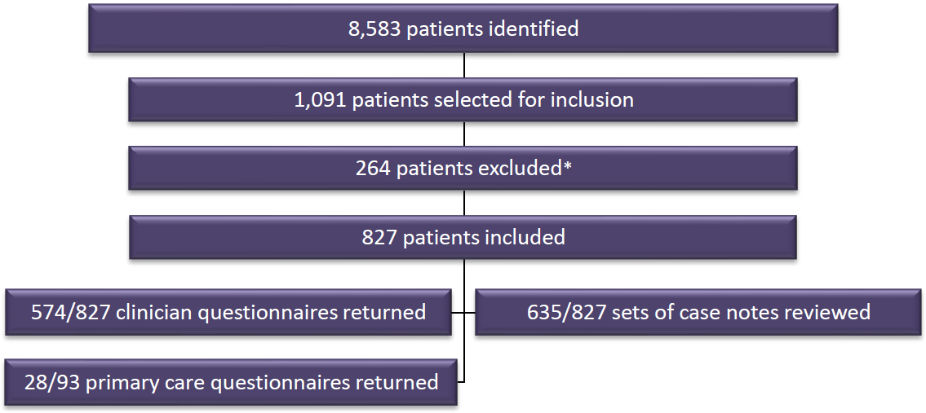
Study sample
Notes:
Presenter’s notes:
Clinical data
In total, 8,583 patients were initially identified between 1st April 2021 – 31st March 2022 as meeting the study criteria. This included patients who were admitted with testicular torsion; orchitis and epididymitis, and ‘other’ specified disorders of male genital organs, according to the coding.
Of the 1,091 patients sampled for inclusion, 264 were subsequently excluded. The main reasons for exclusion were that the patient was found not to have torsion during their procedure (n=219), or the operation was undertaken on an elective basis (n=40).
Organisational data
Organisational questionnaires were returned from 143/207 (69.1%) hospitals.
Survey data
The patient and parent/carer survey was completed by 17 respondents. The clinician survey was completed by 580 respondents (including 318 urologists); emergency medicine; anaesthetists; paediatrians; and GPs.

Slide 5
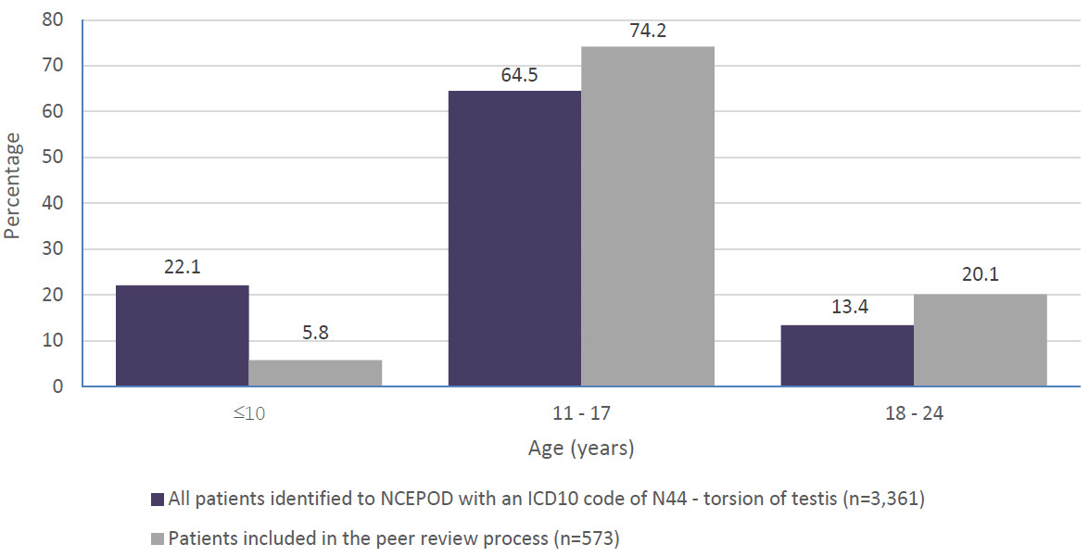
Age of patients included in the study population
Notes:
Presenter’s notes:
The majority of patients included in the peer review process were aged between 13 and 16 years (305/573; 53.2%) with a median age of 15 years.
When compared with the population of all patients identified to NCEPOD with an ICD10 code of N44 (torsion of testis), the group included in the peer review process were skewed towards the older age groups.

Slide 6
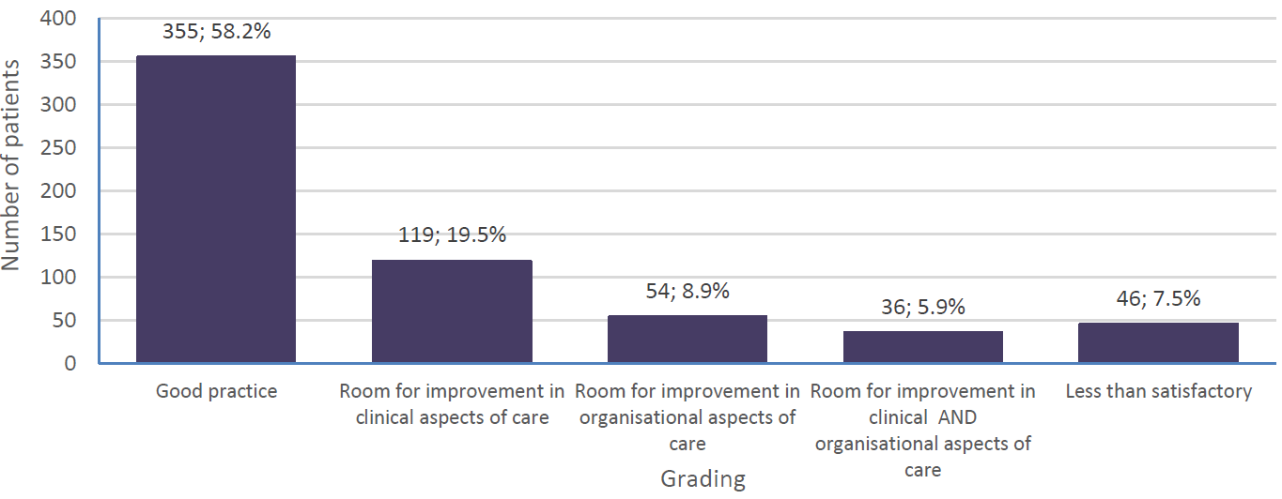
Overall quality of care
Notes:
Presenter’s notes:
The case reviewers assessed the overall quality of care as good 355/610 (58.2%) patients. Care was less than satisfactory for 46/610 (7.5%) patients. There was room for improvement in either the clinical or organisational aspects of care, or clinical and organisational aspect of care in 209/610 (34.3%) patients.

Slide 7
Key message 1
Raise public awareness about testicular torsion
Steps in maternity/antenatal care (e.g. advice for care of a new baby in the red book) and post-natal care should be taken to educate parents/carers about the pathology and early warning signs of testicular torsion. The need to urgently attend an emergency department, and not ‘wait and watch’, to achieve surgical intervention (if necessary) within six hours when testicular pain is experienced is a critical component of this education. The health curriculum from nursery through to higher education needs to involve advice about testicular torsion.

Slide 8
Key message 2
Training to recognise testicular torsion in primary and emergency care
Training modules require updating to enable primary care and emergency staff to recognise atypical signs of testicular torsion and the need to enact urgent referral pathways for timely surgical intervention.

Slide 9
Key message 3
Reduce in-hospital delays through clear, documented pathways of care and transfer
Transfers should be minimised where intervention can be performed on-site. Where transfers are unavoidable, patients must be transferred to a centre where scrotal explorations can be performed safely on-site with a pre-alert system in place to inform the receiving hospital of an incoming transfer. Transfers must also be classed as urgent with the aid of clear and documented protocols and pathways. Auditing of the testicular torsion pathway, at least annually, is essential to identify areas for improvement.

Slide 10
Key message 4
Senior assessment and investigations
Patients with suspected testicular torsion should have an urgent referral and clinical review by a senior surgical decision-maker (minimum ST3 or equivalent) specialising in urology, paediatric surgery, or general surgery. A consensus must also be made on the use of Doppler ultrasound on patients with suspected testicular torsion.

Slide 11
Public awareness and education
Raise awareness about testicular torsion, including the need to urgently attend an emergency department if someone experiences testicular pain. This should include a continued public awareness campaign for all who may be affected, including parents/carers, and raised at all stages of development:
  Maternity/antenatal care (e.g. advice for care of a new baby in the red book) and post-natal care.
  Nursery education.
  The health education curriculum in primary and secondary education.
  Further/higher education.
Primary audiences - national: NHS England, Office for Health Inequalities and Disparities, Welsh Government, Public Health Wales, Department of Health Northern Ireland, Public Health Agency, Departments of Education.
Primary audiences - local: Midwives, health visitors, special educational needs staff, school nurses.
Supported by: Royal College of Midwives, Royal College of Paediatrics and Child Health, British Association of Paediatric Urologists, British Association of Paediatric Surgeons, Association of Paediatric Anaesthetists of GB and Ireland, British Association of Urological Surgeons, Royal College of Surgeons, Association of Surgeons of GB and Ireland, Getting It Right First Time, Commissioners, Integrated Care Boards.
Notes:
Eight recommendations have been agreed as the primary focus for action, based on the report findings. Each recommendation falls under five parts of the pathway.

Slide 12
Recognition of testicular torsion in primary care and the emergency department
Update training modules for primary care, and emergency department staff, to emphasise the importance of early recognition of testicular torsion, including atypical or warning presentations, urgent referral pathways and timely surgery.
Primary audiences: NHS 111, Ambulance Trusts, Royal College of General Practitioners, Royal College of Emergency Medicine.
Supported by: British Association of Paediatric Urologists, British Association of Paediatric Surgeons, Association of Paediatric Anaesthetists of GB and Ireland, British Association of Urological Surgeons, Royal College of Surgeons, Association of Surgeons of GB and Ireland, Royal College of Paediatrics and Child Health, NHS England, Welsh Government, Department of Health Northern Ireland.

Slide 13
Pathway up to and including hospital arrival
Reduce delays for patients with testicular pain/suspected testicular torsion by:
  Minimising transfers to another hospital by referring patients to a hospital where scrotal exploration can be performed safely on-site – ideally including a pre-alert to the receiving hospital.
  Ensuring that any essential transfer is as urgent as possible*, including when patients self-present but need to be at another hospital.
  Having a clear, documented clinical pathway of care for patients with testicular pain/suspected testicular torsion in hospitals where surgery for testicular torsion is undertaken, which is communicated to all healthcare professionals involved in the care of this group of patients.
  Auditing the testicular torsion pathway, at least annually, to identify areas for improvement.
Primary audiences - national: Royal College of General Practitioners, NHS 111, Ambulance Trusts
Primary audiences - local: Medical Directors, Directors of Nursing, Integrated Care Boards, Operational Delivery Networks Commissioners
Supported by: British Association of Paediatric Urologists, British Association of Paediatric Surgeons, Association of Paediatric Anaesthetists of GB and Ireland, British Association of Urological Surgeons, Royal College of Surgeons, Association of Surgeons of GB and Ireland, Royal College of Paediatrics and Child Health, Royal College of Emergency Medicine, Royal College of Anaesthetists, Association of Anaesthetists, Royal College of Radiologists, NHS England, Welsh Government, Department of Health Northern Ireland.

Slide 14
Pathway in hospital
Patients with suspected testicular torsion should have an urgent* referral and clinical review by a senior surgical decision-maker (minimum ST3 or equivalent) specialising in urology, paediatric surgery, or general surgery.
*NCEPOD Classification of Intervention
Primary audiences - national (to agree a timeframe): NHS England, Welsh Government, Department of Health Northern Ireland, British Association of Paediatric Urologists, British Association of Paediatric Surgeons, Association of Paediatric Anaesthetists of GB and Ireland, British Association of Urological Surgeons, Royal College of Surgeons, Association of Surgeons of GB and Ireland, Royal College of Emergency Medicine.
Primary audiences - local: Emergency Medicine Physicians, Paediatric Surgeons, Urologists, General Surgeons, Anaesthetists, Radiologists
Supported by: Medical Directors, Directors of Nursing

Slide 15
Pathway in hospital
A consensus is needed on the role of Doppler ultrasound in the care pathway for suspected testicular torsion to aid surgical decision-making whilst not adding delay to surgery.
Primary audiences: British Association of Urological Surgeons, British Association of Paediatric Urologists, British Association of Paediatric Surgeons, Association of Paediatric Anaesthetists of GB and Ireland, Royal College of Paediatrics and Child Health, Royal College of Radiologists, Royal College of Surgeons, Association of Surgeons, National Institute for Health and Care Excellence
Supported by: NHS England, Welsh Government, Department of Health Northern Ireland, medical directors, National Institute for Health and Care Research Health Technology Assessment

Slide 16
Pathway in hospital
Perform surgery for testicular torsion as an immediate or urgent procedure (NCEPOD 1 or 2)*, once the decision to operate has been made.
*NCEPOD Classification of Intervention
Primary audiences: Consultant Surgeons, Consultant Anaesthetists
Supported by: Clinical Directors and Medical Directors

Slide 17
Discharge and follow-up
Discharge information for patients, and parent/carers should include:
  Delayed side effects that might occur following orchidectomy, or the risk of late testicular atrophy in patients who had an operation that led to no orchidectomy, but fixation (orchidopexy), including risks to fertility.
  Details of patient-initiated follow-up (PIFU) follow-up e.g. to discuss prosthetic implants for patients who underwent an orchidectomy.
  How to access psychological support.
Primary audiences: The medical team or specialist nurses caring for patients following surgery for testicular torsion.
Supported by: Clinical Directors and Medical Directors.

Slide 18
Discharge and follow-up
Review the care of all patients who underwent an orchidectomy in a multidisciplinary morbidity and mortality meeting. This should include primary care and, ideally a regional approach to shared-learning and quality improvement.
Primary audiences: The medical team or specialist nurses caring for patients following surgery for testicular torsion.
Supported by: Clinical Directors and Medical Directors.

Slide 19
Discussion
Are signs of testicular torsion included in maternity/antenatal care (e.g. advice for care of a new baby in the red book) and post-natal care.?
Are ED staff trained on how to recognise early warning signs of testicular torsion?
Does the hospital have a clear, documented pathway or transfer protocol for patients with testicular pain/suspected testicular torsion that is known by all healthcare professional?
Does the hospital have a senior urologist on site out of hours?
Is a Doppler ultrasound used? And if so, does it cause delays to treatment?
Are patients who undergo orchidectomies offered a PIFU to discuss prosthetic implants?
Notes:
Final slide for the presenter to begin a discussion

Slide 20
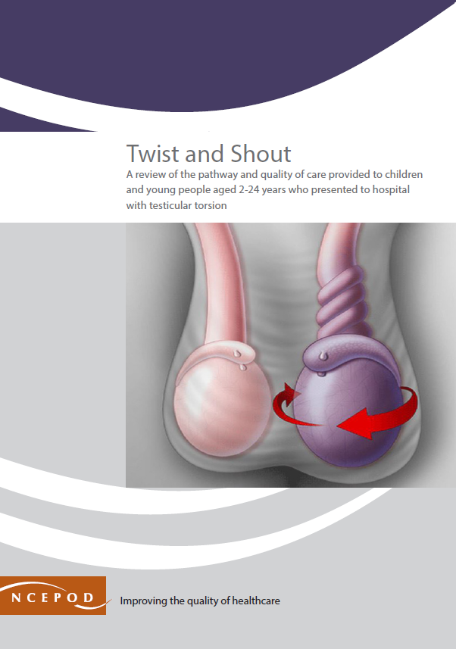
Twist and Shout
Full report, summary and implementation tools are be found at
https://ncepod.org.uk/2024testiculartorsion.html
Notes:
Final slide for the presenter to begin a discussion

